Slide 1
Applied Cryptography confidentiality, integrity, authentication, non-repudiation, cryptosystem, key, plaintext, ciphertext, encryption rule, decryption rule, mod
Liangfeng Zhang
School of Information Science and Technology
ShanghaiTech University

Slide 2
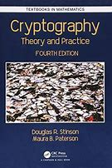
Course Information
Course Materials: lecture slides, homework questions, other materials
Piazza: https://piazza.com/class/kzjyi3flo0t3sj (Q&As)
Blackboard: https://egate.shanghaitech.edu.cn/new/index.html
Homework Submission: submit a soft copy (pdf/jpg) of HW solutions
Gradescope: https://www.gradescope.com/courses/370557
Entry code: D5723D
Office Hour: SIST 2-202.i, 8-9pm, Wednesday
Evaluation:
Attendance: 10%
Homework: 60% (no plagiarisms!!!)
Final Exam: 30%
Textbook: Cryptography: Theory and Practice (4th edition)
Authors: Douglas Robert Stinson, Maura Paterson

Slide 3
Information Security
The protection of information and information systems from unauthorized access, use, disclosure, disruption, modification, or destruction in order to provide confidentiality, integrity, and availability.
CNSSI No. 4009
Committee on National Security Systems Glossary
Availability
Security
Objectives
Confidentiality
Integrity

Slide 4
Cryptography
The study of mathematical techniques for securing digital
information, systems, and distributed computations
against adversarial attacks
“Introduction to Modern Cryptography”, 2015
The study of mathematical techniques related to aspects of information security such as confidentiality, data integrity, entity authentication, and data origin authentication
“Handbook of Applied Cryptography”, 1996
The discipline that embodies the principles, means, and
methods for the providing information security, including
confidentiality, data integrity, non-repudiation, and
authenticity.
CNSSI No. 4009

Slide 5


Confidentiality
“Transfer $1000 from Alice to David”
Alice
Bob (bank)
Charlie
adversary
The property that sensitive information is not disclosed to unauthorized individuals, entities, or processes.
FIPS 140-2
Chapter 4: Block ciphers and stream ciphers
Chapter 6: The RSA Cryptosystem and Factoring Integers
Chapter 7: Public-Key Cryptography and Discrete Logarithms

Slide 6
Integrity
“Transfer $1000 from Alice to David”
Alice
Bob (bank)
Charlie

Slide 7
Integrity
“Transfer $1000 from Alice to Charlie”
Alice
Bob (bank)
Charlie

Slide 8
Integrity
“Transfer $10000 from Alice to Charlie”
Alice
Bob (bank)
Charlie
The property that sensitive data has not been modified or deleted in an unauthorized and undetected manner.
FIPS 140-2
Chapter 5: Hash Functions and Message Authentication
Chapter 8: Signature Schemes

Slide 9
Authentication
“Transfer $1000 from Alice to Charlie”
Alice
Bob (bank)
Charlie
The process of establishing confidence in the identity of users or information systems.
SP 800-63

Slide 10


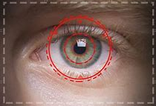


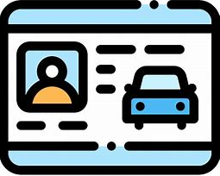
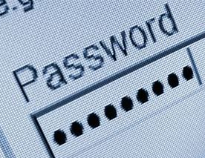
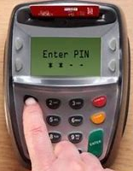
Authentication
How to prove you are you to other people?
Three factors of entity authentication
What you are
behavioral and physical attributes
What you have
documents or credentials
What you know
passwords, personal information
two-factor authentication
Bank machine withdrawals: bank card + PIN
Online banking: password + U shield/SMS code
face
fingerprint
retina
ID card
passport
driver’s L.
password
PIN
Chapter 10: Identification Schemes and Entity Authentication

Slide 11
Non-Repudiation
“Transfer $1000 from Alice to David”
$$I never send this instruction‼!$$
Alice
Bob (bank)
$$I never receive this instruction‼!$$
Assurance that the sender of information is provided with proof of delivery and the recipient is provided with proof of the sender’s identity, so neither can later deny having processed the information.
CNSSI-4009; SP 800-60
Chapter 8: Signature Schemes
Other (Advanced) topics?

Slide 13
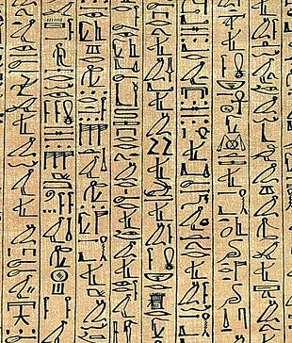
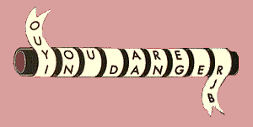
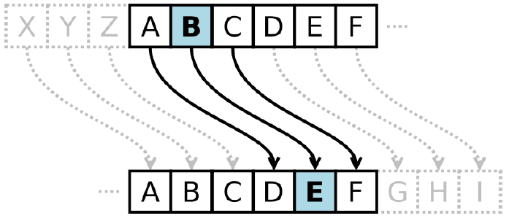
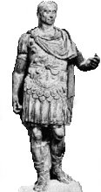
Classical Cryptography
Hieroglyph (Egypt, 1900BC)
Scytale (Greece, 405BC)
Cuneiform signs (Mesopotamian,1500BC)
Caesar’s Cipher (Rome, 50-60BC)

Slide 14
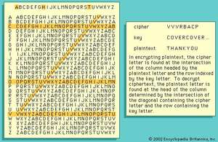
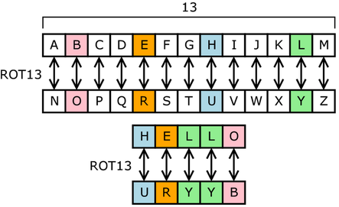
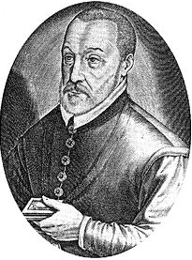
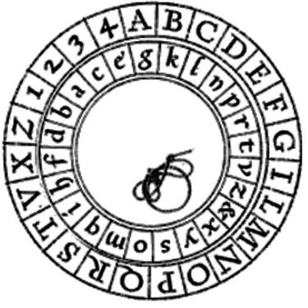
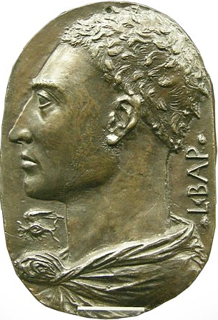
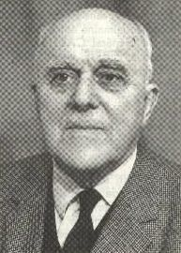
Classical Cryptography
1523-1596
Substitution cipher
Vigenère cipher (1587, broken in 1863)
 | A | D | F | G | X
A | b | t | a | l | p
D | d | h | o | z | k
F | q | f | v | s | n
G | g | i/j | c | u | x
X | m | r | e | w | y
1404-1472
Fritz Nebel
1891-1977
Alberti cipher disk (1467)
ADFGX Cipher (1918)

Slide 15
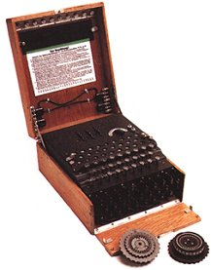
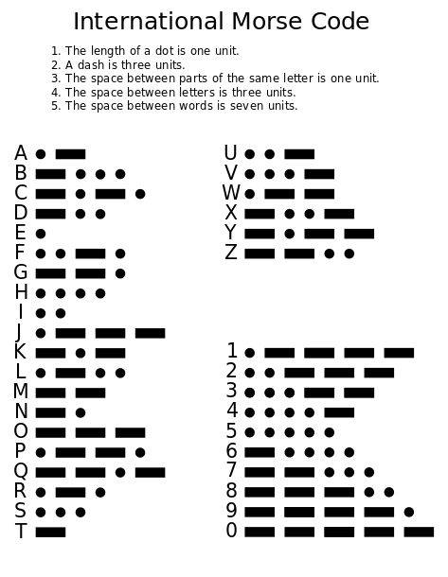
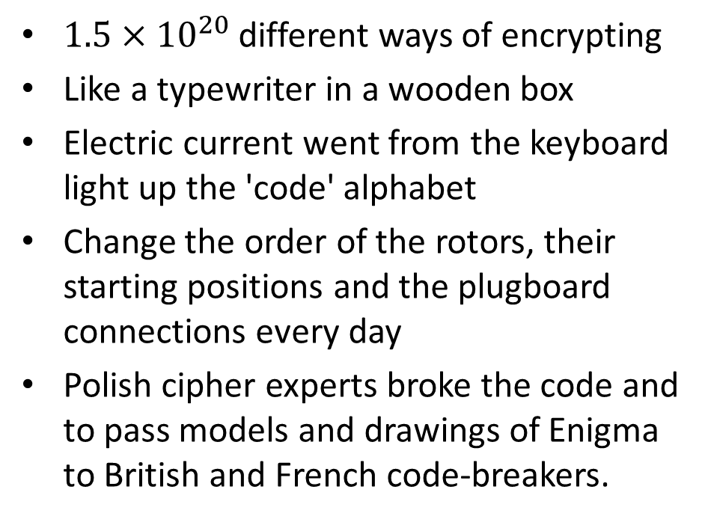
Rotor Machine
$1.5×{10}^{20}$ different ways of encrypting
Like a typewriter in a wooden box
Electric current went from the keyboard light up the 'code' alphabet
Change the order of the rotors, their starting positions and the plugboard connections every day
Polish cipher experts broke the code and to pass models and drawings of Enigma to British and French code-breakers.
Enigma (Germany, 1920s)
Morse Code (1836)

Slide 16
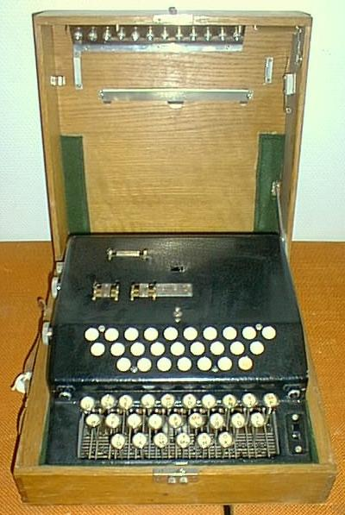
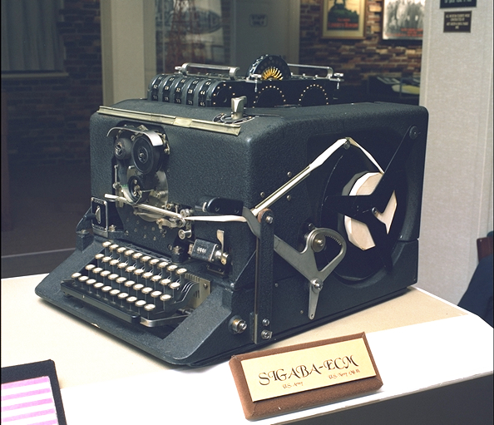
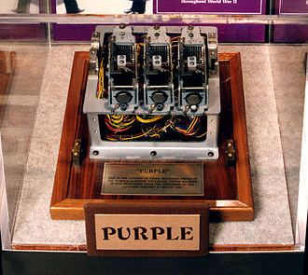
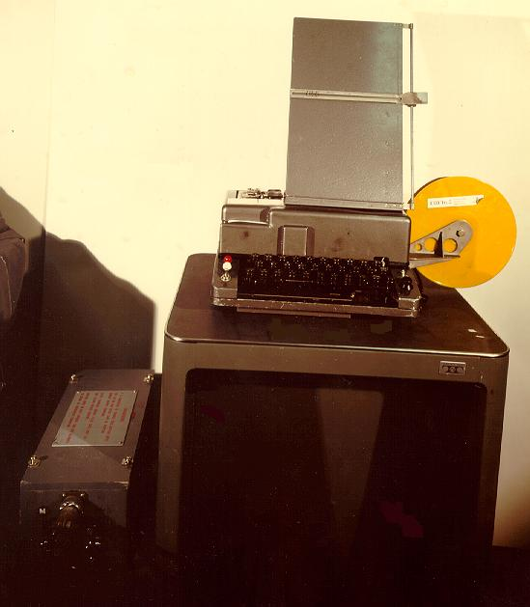
Rotor Machine
B-21 (Hagelin, Swedish, 1925)
SIGABA (US, unbroken, 1941)
Japanese Purple Machine (1937)
BID 590 (Noreen, Canada, mid-1960s)

Slide 17
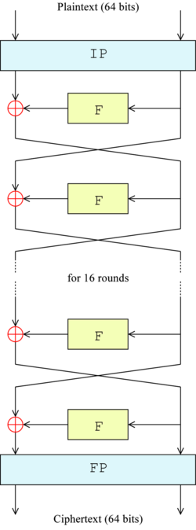
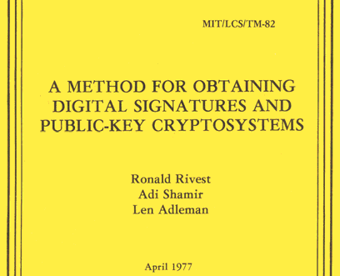
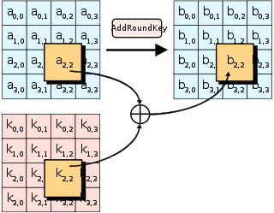
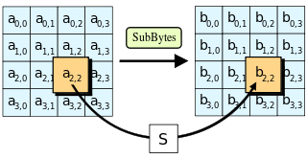
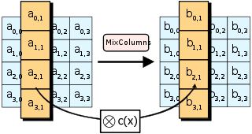
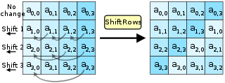
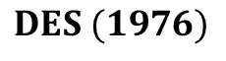
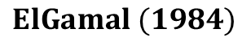
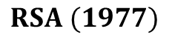
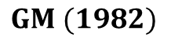
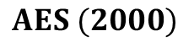
Computer Communication
$$RSA (1977)$$
$$GM (1982)$$
$$DES (1976)$$
$$ElGamal (1984)$$
$$AES (2000)$$

Slide 18
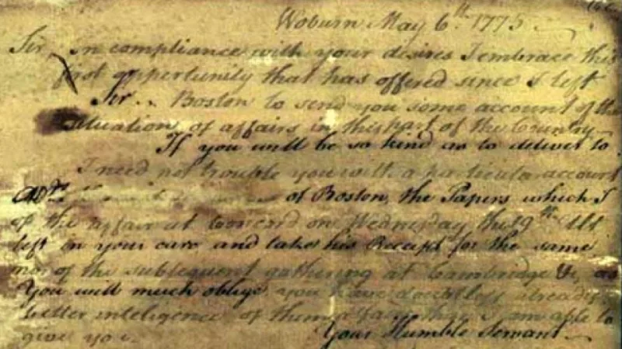
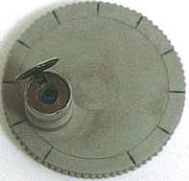
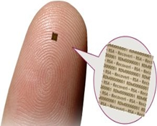
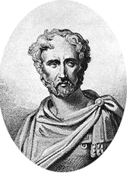
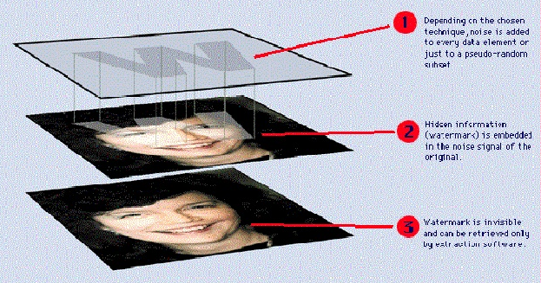
Steganography隐写术
Pliny the Elder
Rome, 23-79
Invisible Ink
Microdot Technology
Digital Watermarking

Slide 20
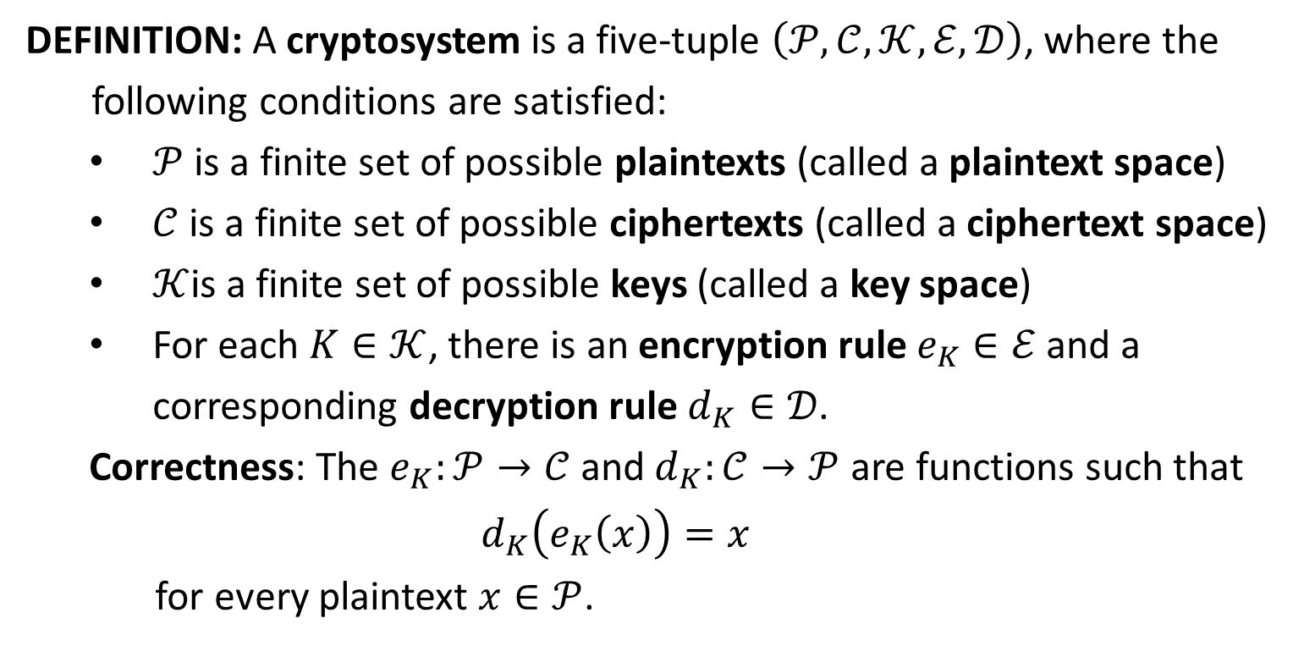
Cryptosystem
DEFINITION: A cryptosystem is a five-tuple $\left(𝒫,𝒞,𝒦,ℰ,𝒟\right)$, where the
following conditions are satisfied:
$𝒫$ is a finite set of possible plaintexts (called a plaintext space)
$𝒞$ is a finite set of possible ciphertexts (called a ciphertext space)
$𝒦$is a finite set of possible keys (called a key space)
For each $K∈𝒦$, there is an encryption rule $e_{K}∈ℰ$ and a corresponding decryption rule $d_{K}∈𝒟$.
Correctness: The $e_{K}:𝒫→𝒞$ and $d_{K}:𝒞→𝒫$ are functions such that
$$d_{K}\left(e_{K}\left(x\right)\right)=x$$
for every plaintext $x∈𝒫$.

Slide 21
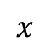
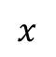

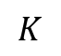
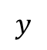
The Communication Channel
Charlie
$$x$$
$$y$$
$$x$$
Alice
encrypter
decrypter
Bob
secure channel
$$K$$
key source
Plaintext: $x=x_{1}x_{2}⋯x_{n}∈𝒫^{n}$
Encryption: $y_{i}=e_{K}\left(x_{i}\right), i=1,2,…,n$
Ciphertext: $y=y_{1}y_{2}⋯y_{n}∈𝒞^{n}$

Slide 23
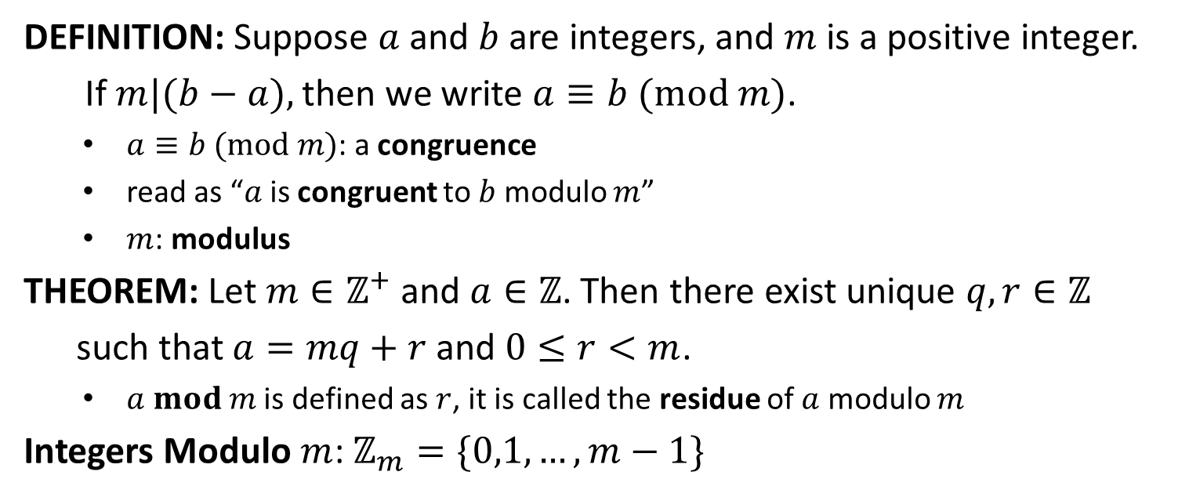
Modular Arithmetic
DEFINITION: Suppose $a$ and $b$ are integers, and $m$ is a positive integer.
If $m|(b−a),$then we write $a≡b (mod m)$.
$a≡b (mod m)$: a congruence
read as “$a$ is congruent to $b$ modulo $m$”
$m$: modulus
THEOREM: Let $m∈ℤ^{+}$ and $a∈ℤ$. Then there exist unique $q,r∈ℤ$
such that $a=mq+r$ and $0≤r<m$.
$a mod m$ is defined as $r$, it is called the residue of $a$ modulo $m$
Integers Modulo $m$: $ℤ_{m}=\{0,1,…,m−1\}$

